Slide 1
On a sheet of paper, draw a table that is 3 squares by 4 squares.
In each box, write one of the following:
65 , 105, D, 10, 90, 5, 31, 64, 175, 12, 45, C, B
You won’t have room for one answer. That’s ok. Leave it off.
You can choose to put them in any box you want.

Slide 2
We will now go through a series of questions. When you find your answer for each question, write the number of the question in the box that contains its answer.
For example, if I thought the answer to #1 were 90, I would write #10 in the box where I wrote 90.
Any team of two that correctly makes an x through the box, will win 50 extra credit points in the classwork category.

Slide 3
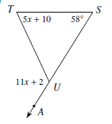
Solve for m<T.
Notes:
X=11, <T=65

Slide 4
In the triangle, n is a whole number. What is the smallest possible value for n?
n n
30
A) 15 B) 12 C) 25 D) 20
Notes:
D

Slide 5
If the measure of each interior angle of a
polygon is 144°, how many sides does this
polygon have?
Notes:
N=10

Slide 6
What is the measure of an exterior angle of a
regular octagon?
Notes:
45

Slide 7
A triangle has sides with lengths of 7 and 15.
Which of the following could be the perimeter
of the triangle?
A) 29
B) 32
C)37
D)44
Notes:
B) 32

Slide 8
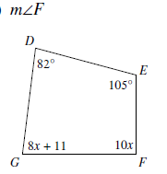
Find the measure of <F
Notes:
X= 9 , F=90, G=83

Slide 9
If the measure of an exterior angle of a regular polygon is 72°, how many sides does the polygon have?
Notes:
N=5

Slide 10
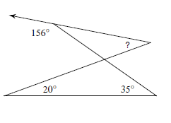
Notes:
31

Slide 11
Which of the following sets of numbers could represent the lengths of the sides of a triangle?
A) 3,7,12
B) 5,4,1
C) 2,6,7
D) 6,2,8
Notes:
C

Slide 12
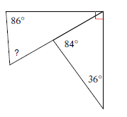
Notes:
64

Slide 13
The measures of the interior angles of an octagon are 155, 145, 35x, 35x, 11x+30, 15x, 170, and 20x. What is the measure of the largest angle?
Notes:
500+116x=1080, x=5, largest angle is 175

Slide 14
A regular convex polygon has 30 sides. What is
the measure of each exterior angle?
Notes:
12

Slide 15
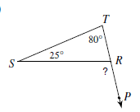
Notes:
?=105

