Slide 1
Introduction to Angles Unit
Parallel Lines
And Transversals
Notes:
Vocab Rating Sheet, Take Notes on paper, transfer info to Frayer Models

Slide 2
Scratch Paper
This is a new strategy we can use to practice remembering things we’ve learned before.
It will help us when we take tests and need to get all the knowledge out of our head and onto paper.
Write down the “angle pair relationships” you remember from when 2 lines intersect

Slide 3
THINK-PAIR-SHARE
check with your neighbor to see if there are any you should add

Slide 4
Review ANGLE PAIR RELATIONSHIPS
LINEAR PAIR
VERTICAL ANGLES

Slide 5
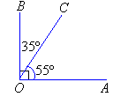
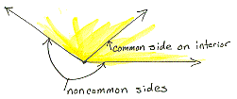
Review Angle pair relationships
Complementary Angles
Adjacent Angles

Slide 6
Parallel Lines And Transversals
Adding another line creates 4 new angle relationships.
When the lines are parallel, we know how the size of each angle relates to the others.

Slide 7
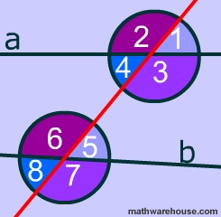
Corresponding angles
If parallel lines are cut by a
transversal,
then the CORRESPONDING
ANGLES ARE CONGRUENT.
Notes:
How many pairs of corresponding angles are possible?

Slide 8
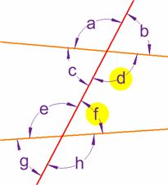
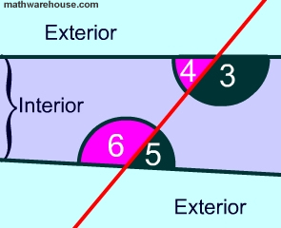
Same-Side (Consecutive) Interior angles
If parallel lines are cut by a transversal,
then the CONSECUTIVE INTERIOR ANGLES are SUPPLEMENTARY.
Notes:
How many consecutive interior angles are possible?

Slide 9
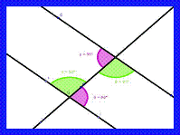
Alternate interior angles
If parallel lines are cut by a transversal,
then the ALTERNATE INTERIOR ANGLES are CONGRUENT.
Notes:
How many pairs of Alt int angles are possible? Explain your reasoning.

Slide 10
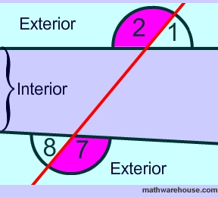
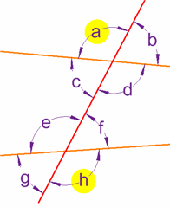
Alternate Exterior Angles
If parallel lines are cut by a transversal,
then the
ALTERNATE EXTERIOR ANGLES
are congruent.
Notes:
How many pairs of Alternate exterior angles are possible? Explain your reasoning.

Slide 11
Frayer Model

